Slide 1

Helm, The package manager for Kubernetes
Jason Zhang, Erin Yang, Wenjie Gu, Shaoling Han
TEAM ANONYMOUS

Slide 2

Overview of Helm
A package manager for k8s (configuration/declarative files)
apt-get in Linux, homebrew in MacOS, pip in python
Simplified definition/installation/upgrading of k8s application
Lower threshold of expertise knowledge (yaml etc.) to use
Easy sharing and version control
All in “one-click”
Notes:
https://helm.sh/

Slide 3
Why bother Helm?
Dozens/hundureds of k8s components: lots of yml files and command lines
A template of versatility, for different fields (teams within a company)
So many pre-made published templates
Notes:
example use cases
https://stackoverflow.com/questions/57137382/can-someone-explain-me-some-use-cases-of-helm

Slide 4
Three Major Concepts of Helm
A Chart
Packaged K8s resources
Contains all resource definitions necessary to run a service inside a Kubernetes cluster
A Repository
Registry of consumable charts
The place where charts can be collected and shared
HelmHub
A Release
An instance of a chart running in a Kubernetes cluster
One chart can be installed multiple times
e.g. MySQL database
Notes:
Bianka’s part
Think of it like the Kubernetes equivalent of a Homebrew formula, an Apt dpkg, or a Yum RPM fill
Helmhub is one such public distributed repository.
each time it is installed, a new release is created
Helm installs charts into K8s,
creating a new release for each installation. And to find new charts, you can search Helm chart repositories.

Slide 5
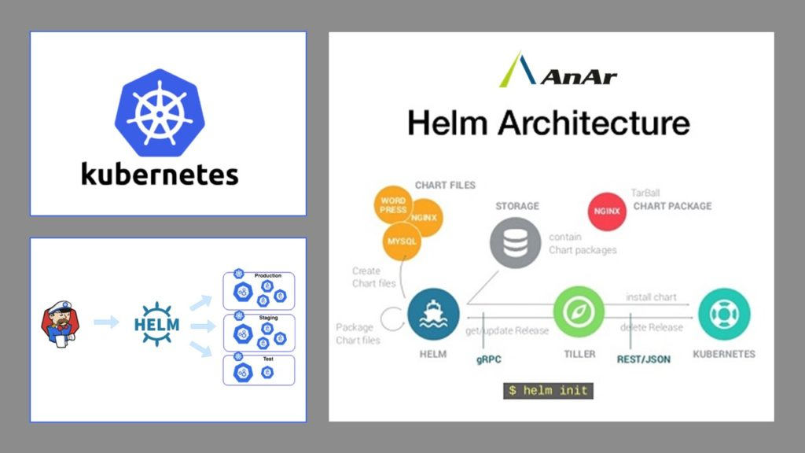
Helm Kubernetes Architecture:
Components:
Helm Client: A CLI for the end users to develop charts locally
Tiller Server: An in-cluster server that interacts with Helm client and interfaces with Kubernetes API
Notes:
Helm Client: It is a command-line client for the end users to develop charts locally. Manage the repositories, interact with the Tiller server, and send finalised charts for installation. Obtain details about release or upgrade it; also uninstall the existing releases when needed.
Tiller Server: It is an in-cluster server that interacts with Helm client and interfaces with Kubernetes API. The server is in charge of addressing incoming requests from the Helm client. It combines chart and configure to build a release, install charts to Kubernetes. Allows tracking the consequent release and uninstall or even upgrade charts.

Slide 6
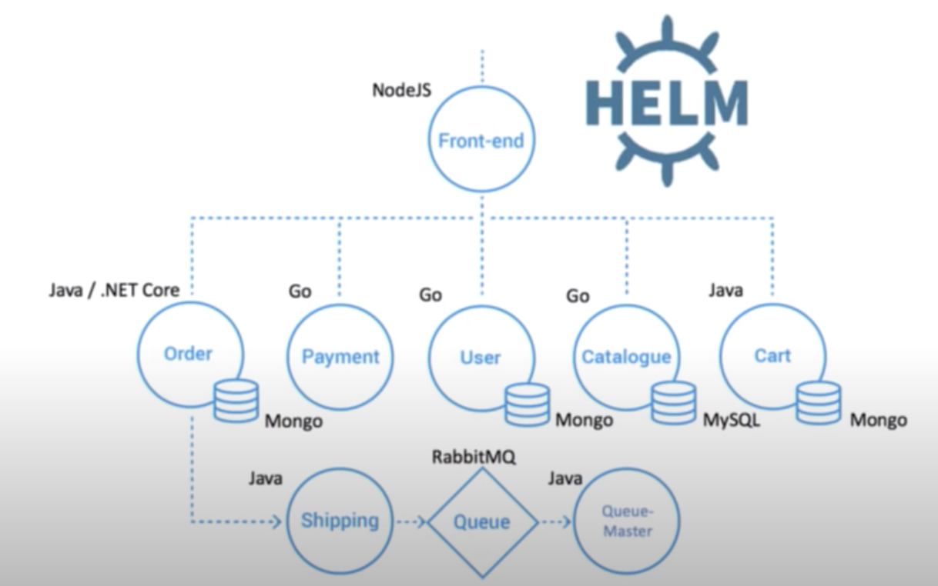
Helm Charts
- Charts: packages of pre-configured Kubernetes resources
- Charts are comprised of a collection of files(mostly yml)
Helm Charts

Slide 7
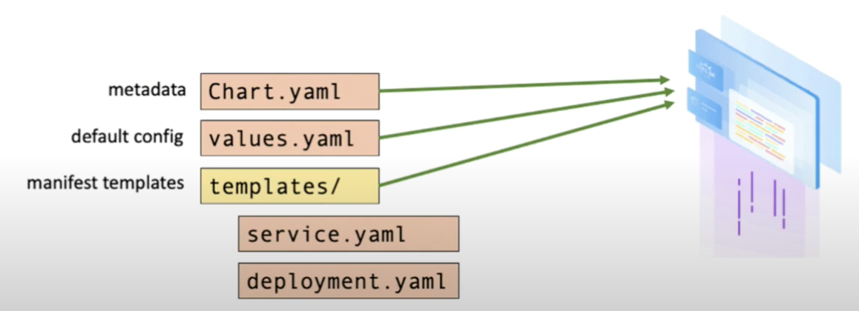
Chart Components
Meta data:
Chart.yml
Default Config:
values.yml
templates :
templates/

Slide 8
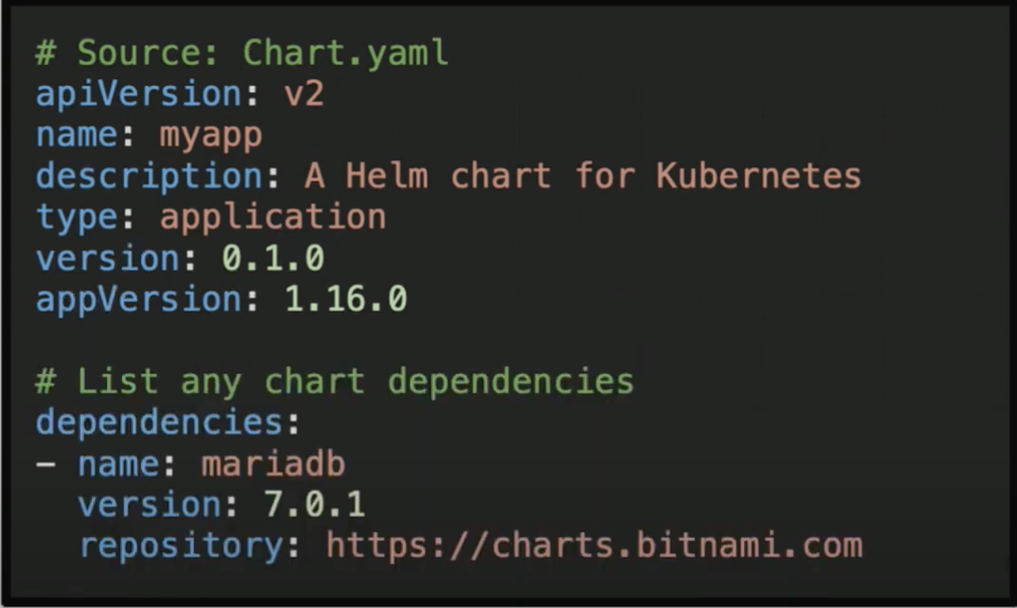
Meta Data: Chart yml
required for a chart
metadata:
chart name
API version
description
dependencies

Slide 9
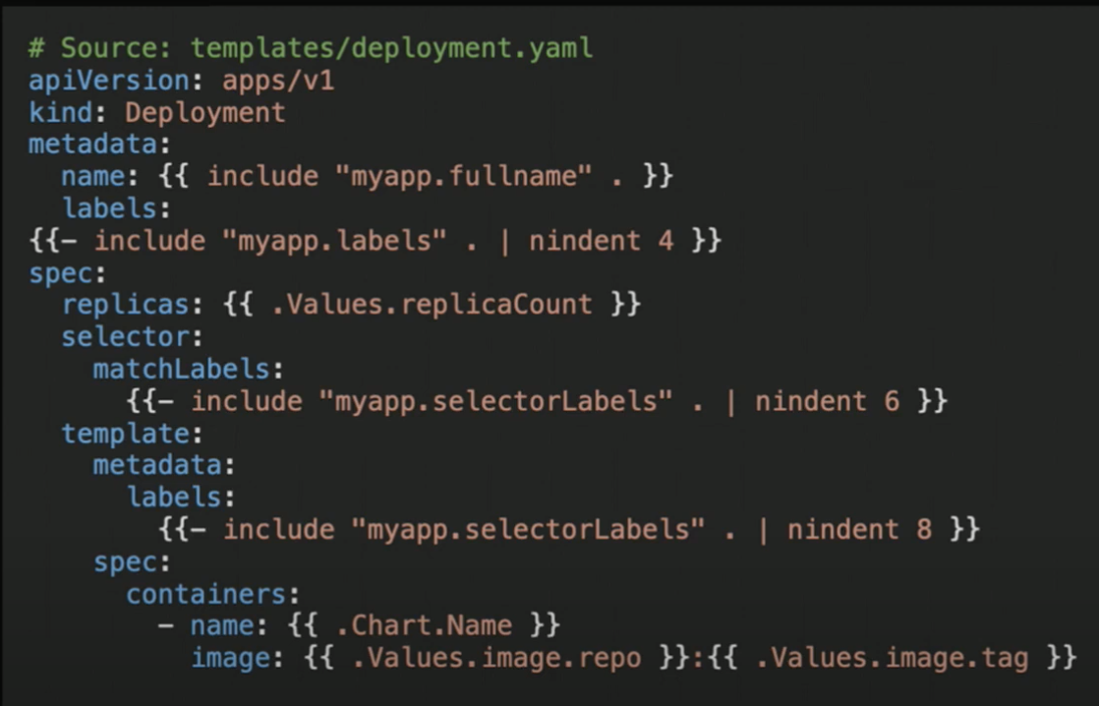
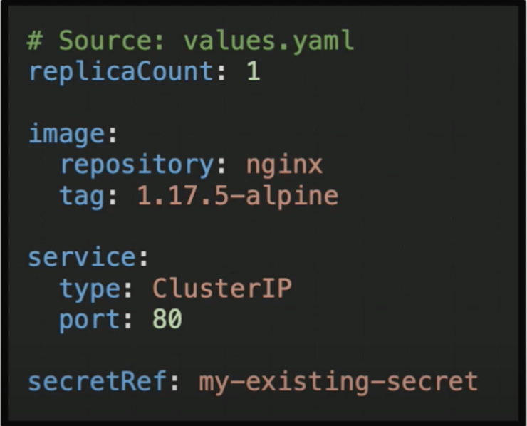
values.yml + template
apply
default setting: values.yml
templates/ xxx.yml

Slide 10
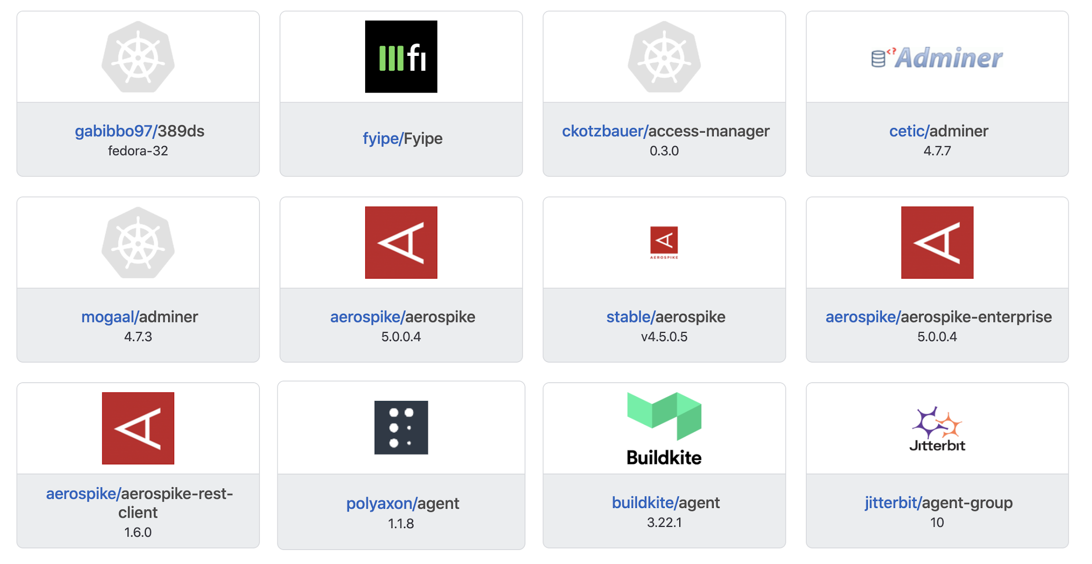
HelmHub
Repository for charts
Public stable and incubator chart repository
Users can push their own charts and share among team
Version-controlled
Notes:
Just like docker hub, helm has its own repository service for ther charts.

Slide 11
Pros and Cons of Helm
Pros:
Reduces complexities of deployment
Version control
Improves Productivity of Developers
Helm Charts allow standardizing and reusing templates in Kubernetes.
Saves efforts duplication
Cons:
First timers can get confused over using the Helm Charts
Steep learning curve
Notes:
Developers can spend a lot of time deploying test environments to test code and replicate customer issues.

Slide 12
Helm Demo
Requirement
Minikube, kubectl, helm
Easy installation using homebrew or yum
MySQL with Replication
Typical in industry, provide high availability and geographic redundancy
One master node and several slave nodes
A very good example of Kubernate Application

Slide 13
Installing without Helm
Procedure:
Deploy server for each node
Create Service
Create a StableSet to start the replication process

Slide 14
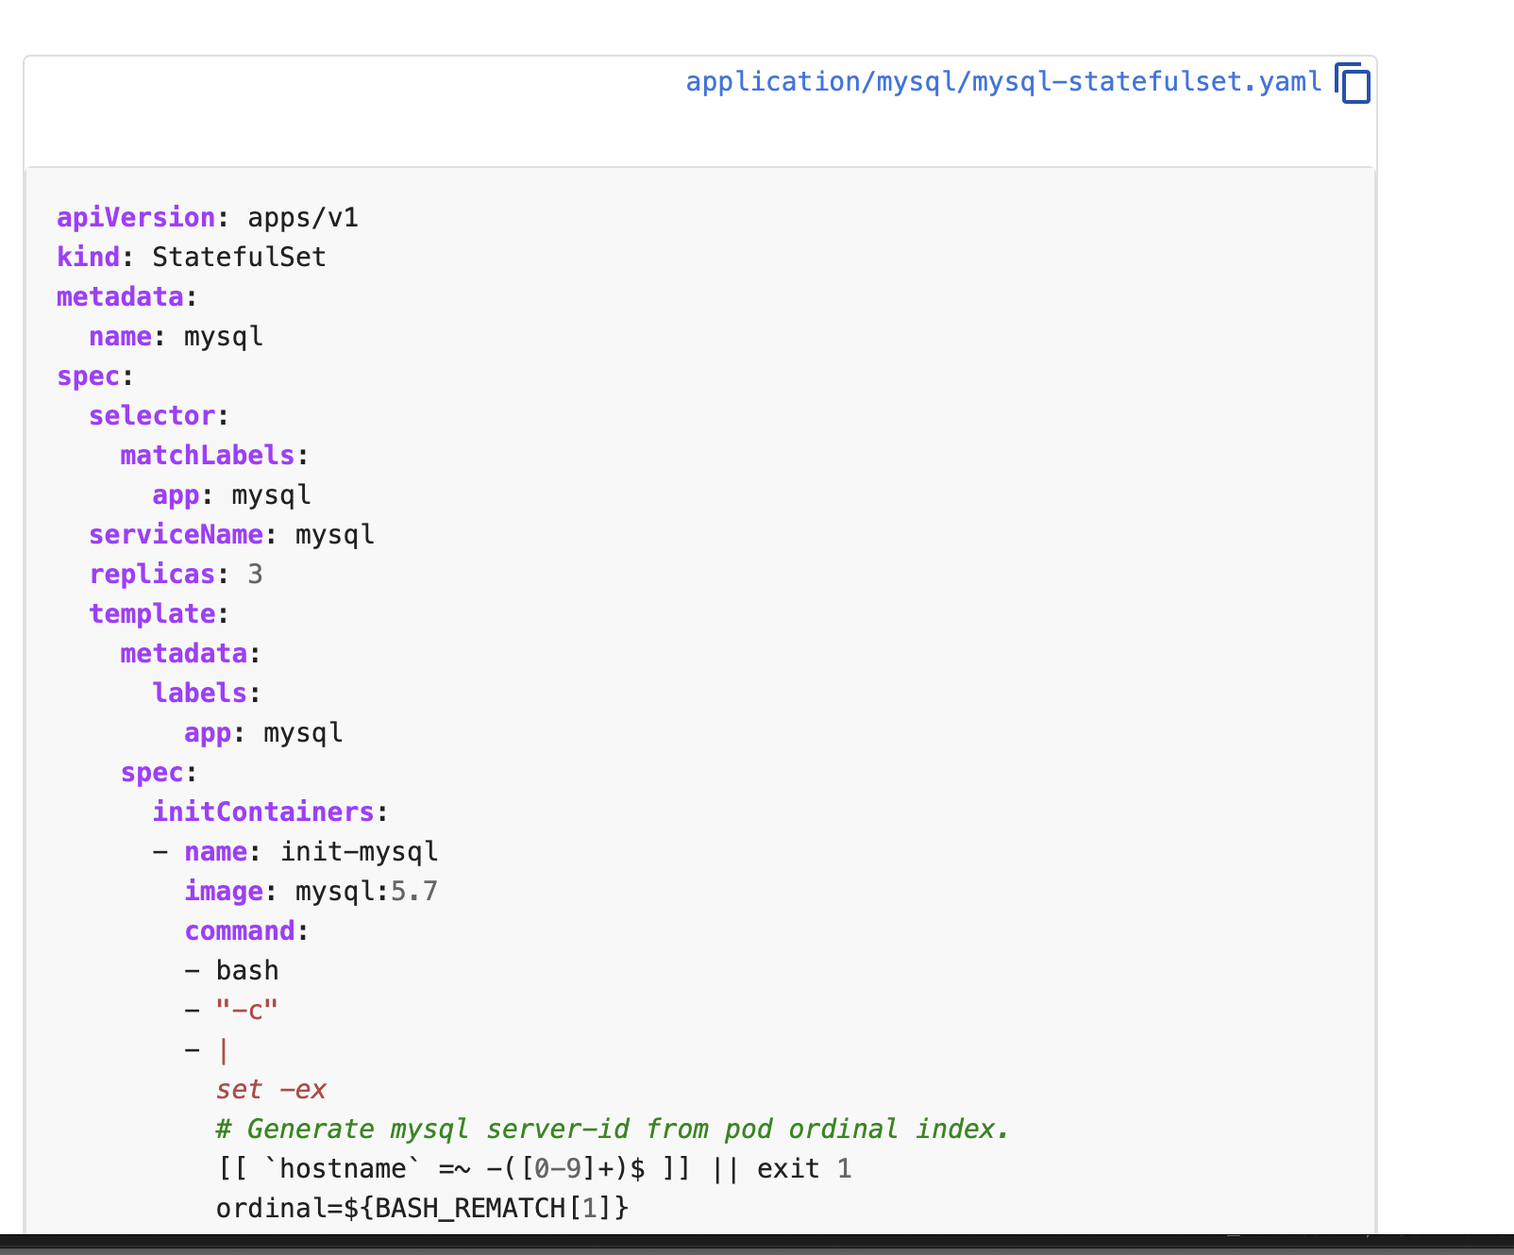
Drawbacks
Complex Procedure
A lot of installation files
Hard to clean up

Slide 15
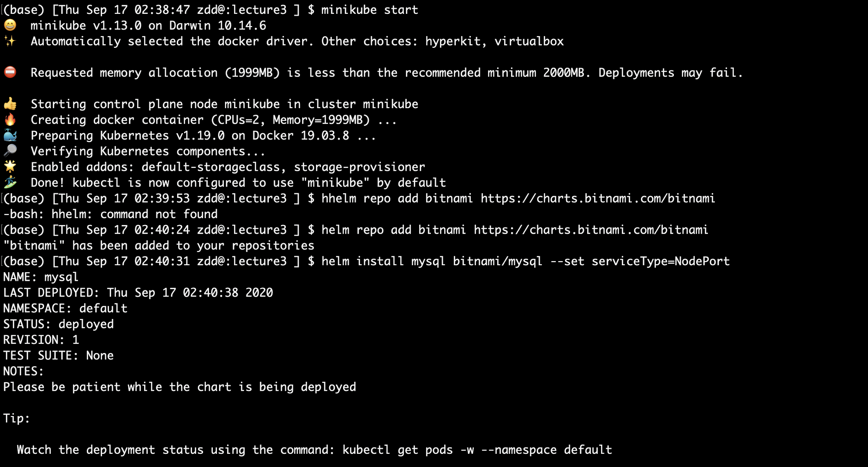
Installation with Helm

Slide 16
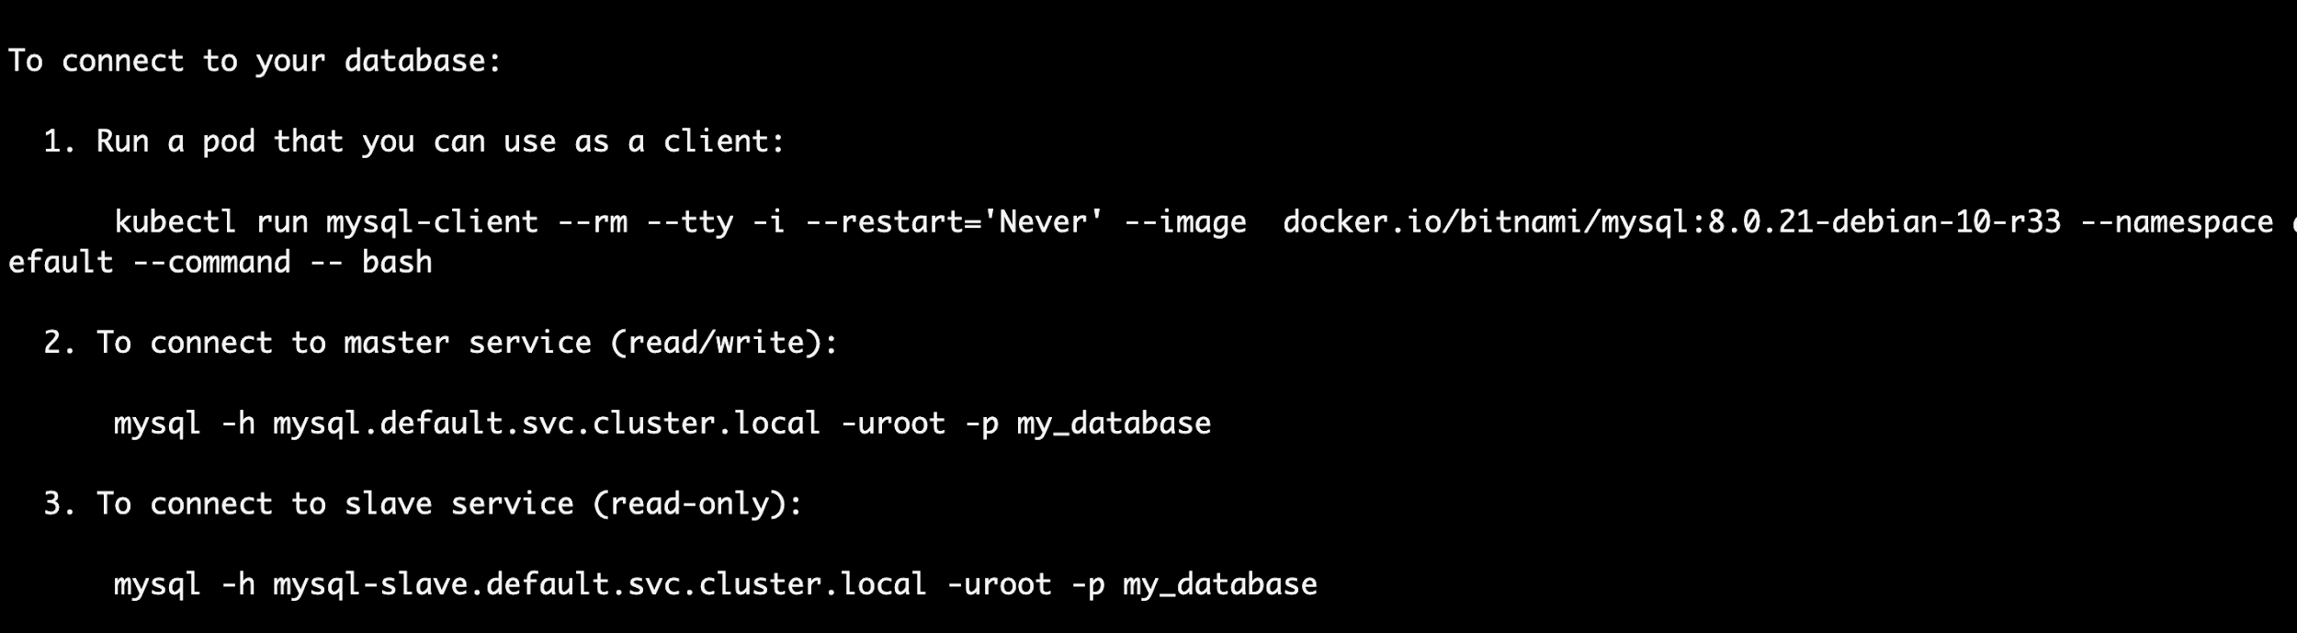
Installation with Helm

Slide 17
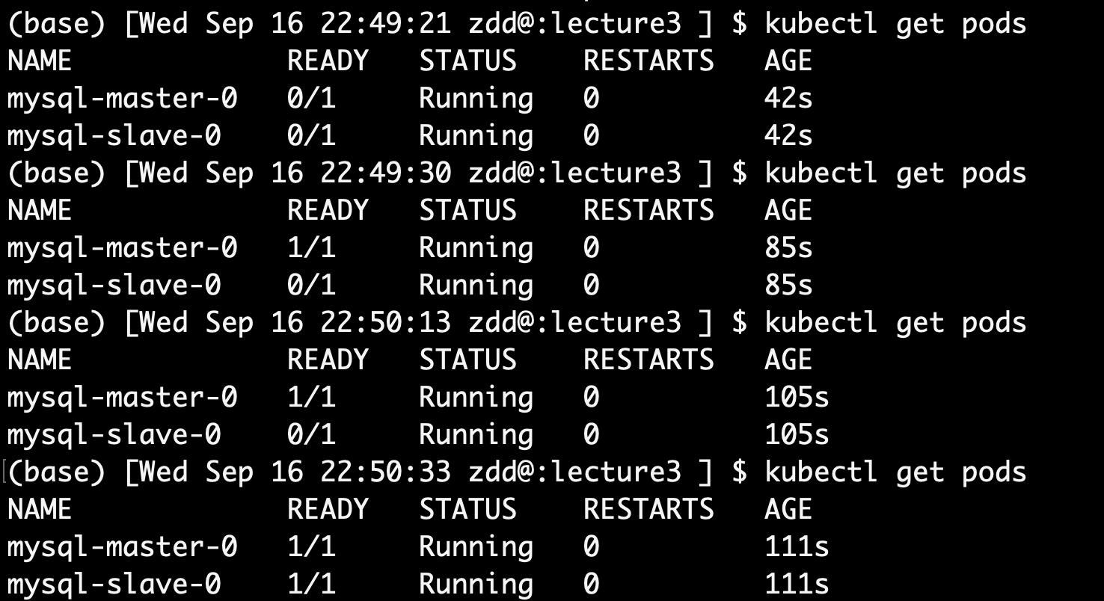
Installation with Helm

Slide 18
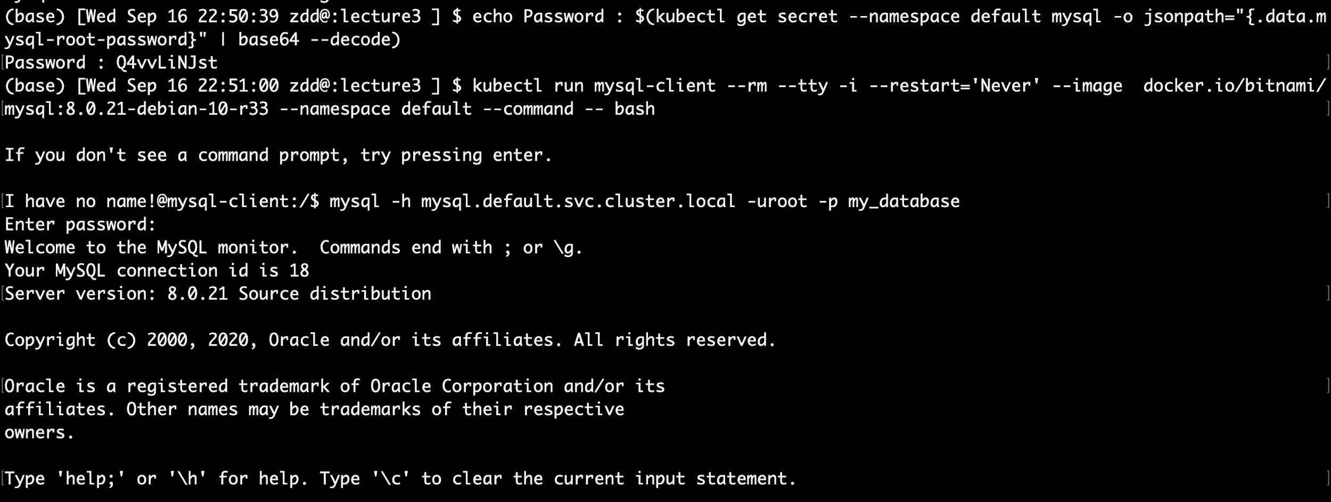
Installation with Helm

Slide 19
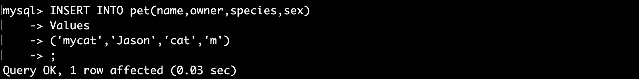
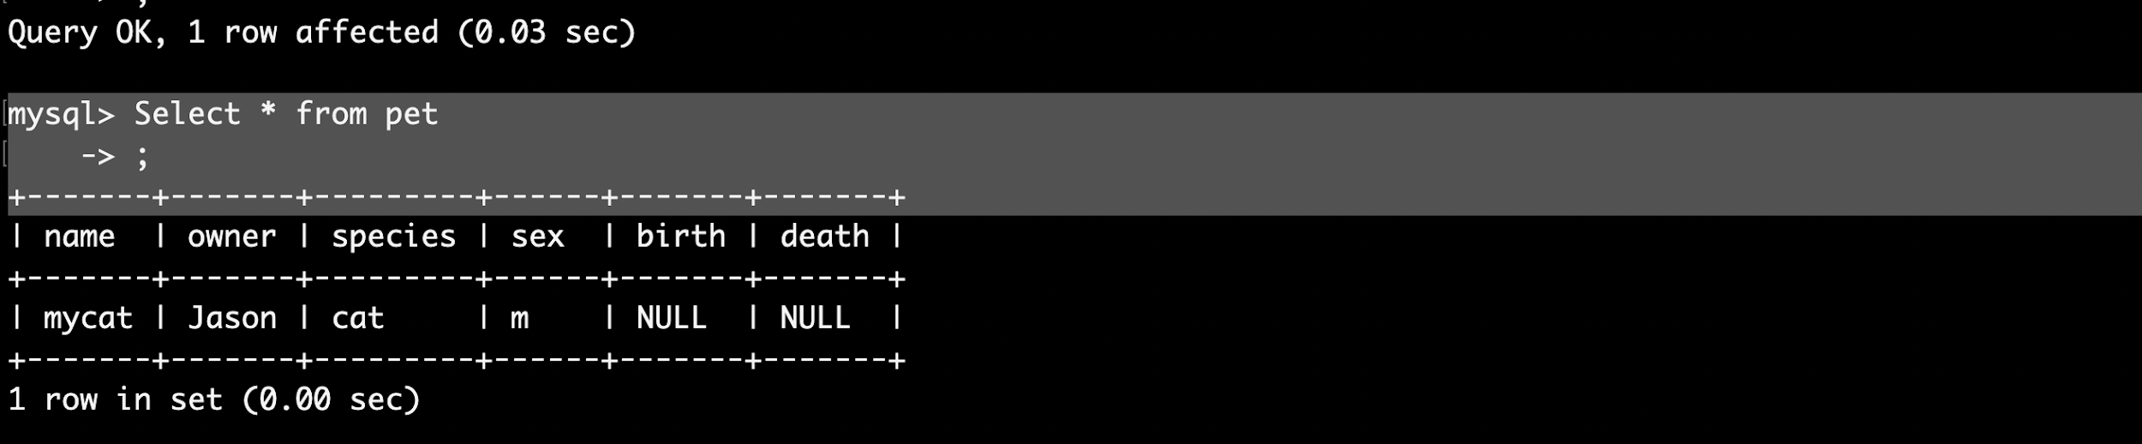
Installation with Helm

Slide 20
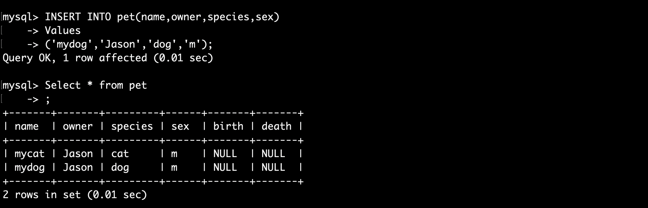
Change in Slaver Node

Slide 21
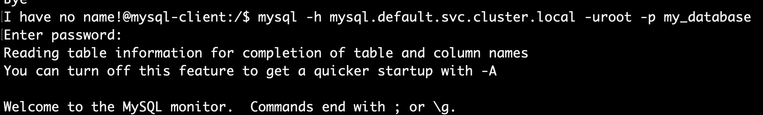
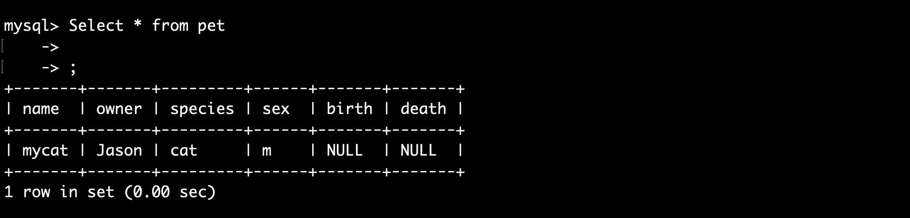
Check Replication

Slide 22
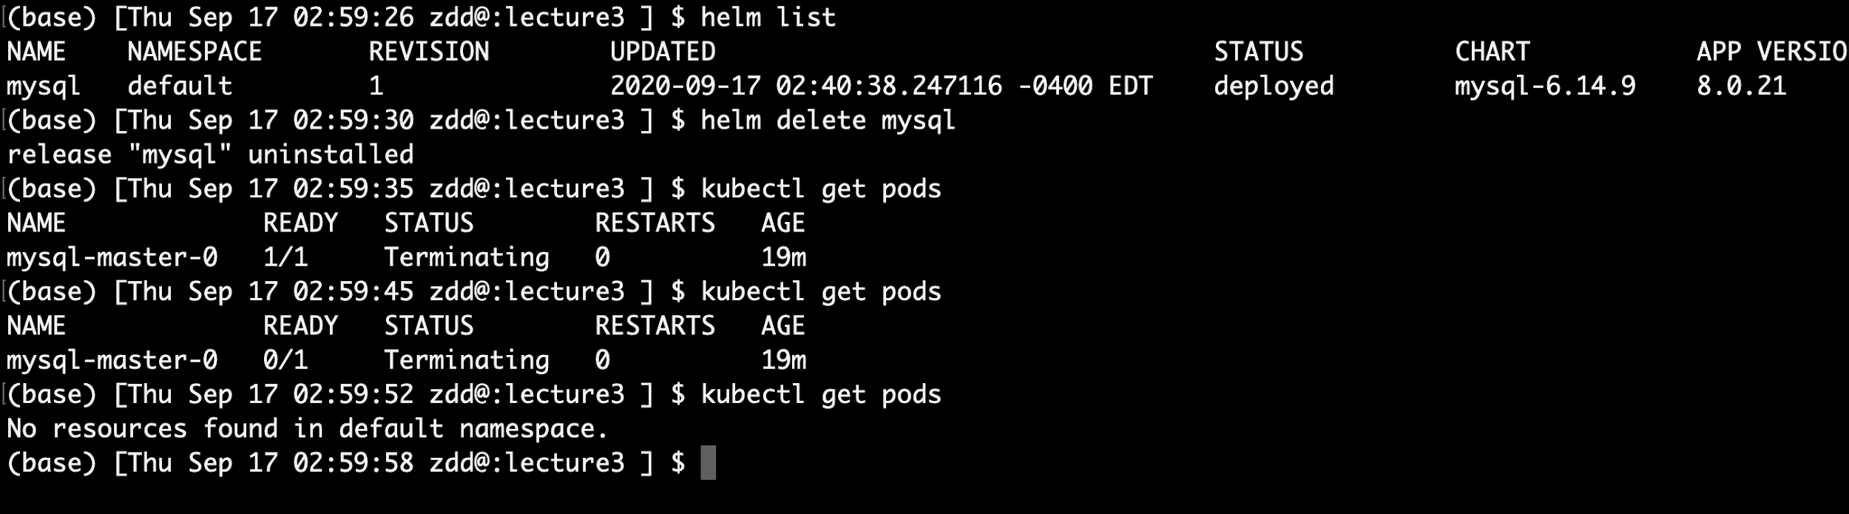
Delete Deployment

Slide 23
Appendix
https://helm.sh/
https://www.youtube.com/watch?v=Jj1Ueq_Lz6A&ab_channel=Codefresh
https://www.youtube.com/watch?v=Zzwq9FmZdsU&t=2s
https://www.youtube.com/watch?v=fy8SHvNZGeE
https://kubernetes.io/docs/tasks/run-application/run-replicated-stateful-application/
https://docs.bitnami.com/kubernetes/get-started-kubernetes/#k8_tutorial_step5
https://kubernetes.io/docs/tutorials/stateful-application/mysql-wordpress-persistent-volume/
https://github.com/helm/hub/blob/master/Repositories.md
http://www.anarsolutions.com/helm-deployments-kubernetes/

Slide 24
Q & A

